Slide 1







CatSat: Problem Solving for CubeSat Engineering, Integration, and Communication
Walter Rahmer
Dr. Christopher Walker, Steward Observatory, University of Arizona
Arizona State University
22 April 2023

Slide 2
Overview
6U Cubesat built by the University of Arizona
~30 x 20 x 10 centimeter box
Onboard:
Inflatable Antenna Technology Demonstration
High Frequency Radio Experiment
HD Camera
HAM Radio Repeater
Data Processing on AstroSDR

Slide 3
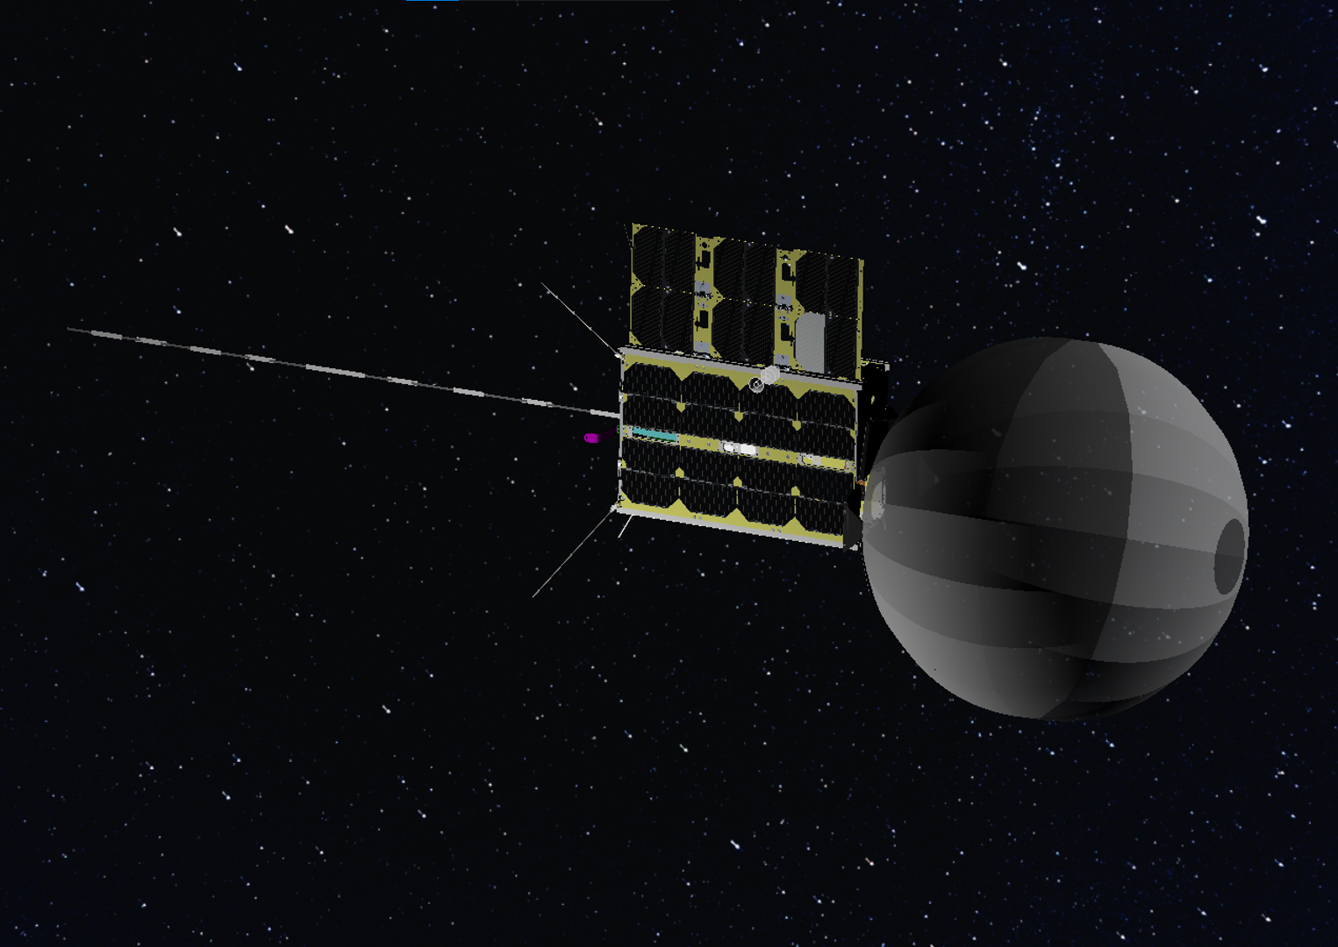
CAD Model of CatSat Deployed in Space.
Image Credit: Aman Chandra, FreeFall Aerospace

Slide 4
My Work
HD Camera – Aperture Correction
Magnetometer – Calibration and testing
AstroSDR – Data capture troubleshooting
Metrology Cameras – Focus Setting
Ground Station – Low Noise Amplifier Installation
Data Processing – Xmidas packet interpretation
Full Spacecraft – Final Assembly
+ More

Slide 5
The HF/WSPR Experiment
The ionosphere is a layer of charged particles in the upper atmosphere that can reflect radio signals, especially around the High Frequency (HF) band.
Understanding this effect is necessary for all radio communication that interacts with the ionosphere (e.g. GPS signals, short wave radio communication).
The ionosphere changes between day and night, and the radio effect during this transient period is poorly understood.

Slide 6
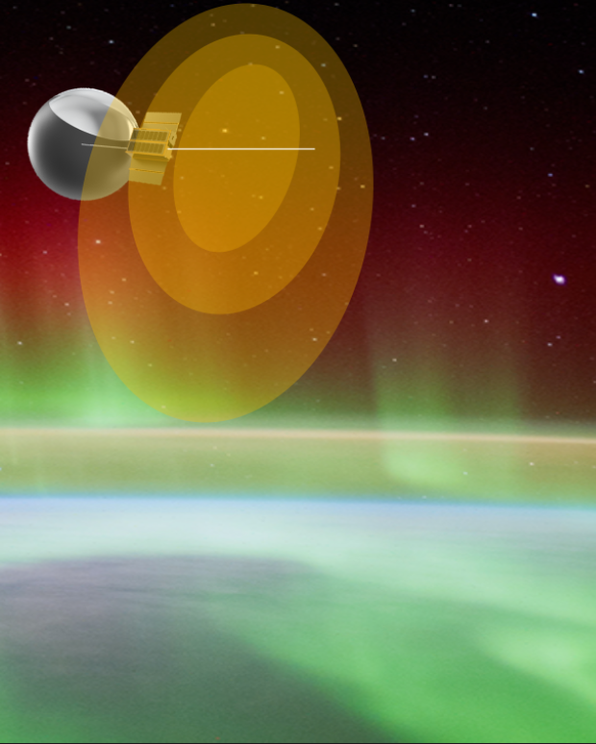
The HF/WSPR Experiment
2-foot whip antenna deployed from the bottom of CatSat
Listen for Weak Signal Propagation Reporter (WSPR) signals from HAM radio stations around the world
Compare received signals to known transmission format
Image credit: Dr. Christopher Walker

Slide 7
My Work on the HF/WSPR Experiment
Problem:
Powering on the HF board draws an extreme spike of current from the batteries, tripping a fuse and restarting the entire system
Solution:
Design and construct a current limiting board to absorb the current spike and prevent it from affecting the batteries
Multiple board designs were tested and iterated over to produce a final design

Slide 8
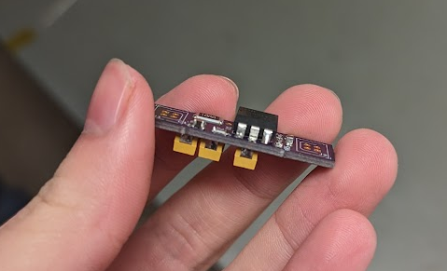
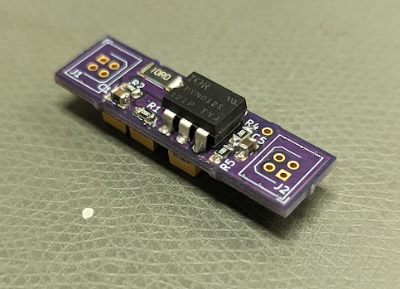
My Work on the HF/WSPR Experiment

Slide 9
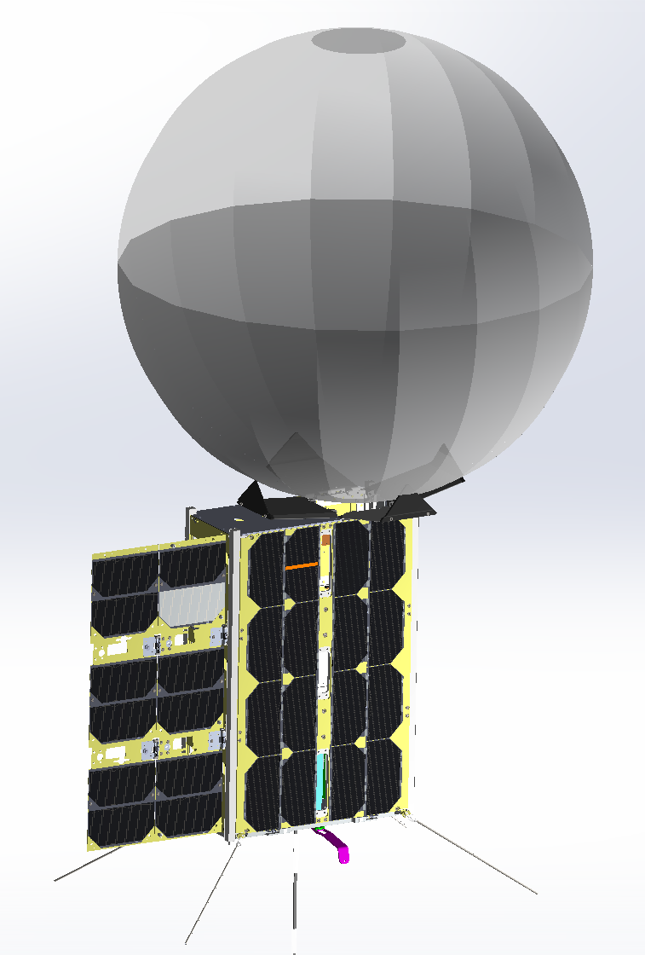
A Glance at the Inflatable Antenna
SmallSats suffer from size and mass constraints, limiting antenna size and speed
CatSat will demonstrate an inflatable spherical antenna design to allow high speed communication
50 Mbps speeds are expected from the 0.5-meter antenna
Image Credit: Aman Chandra

Slide 10
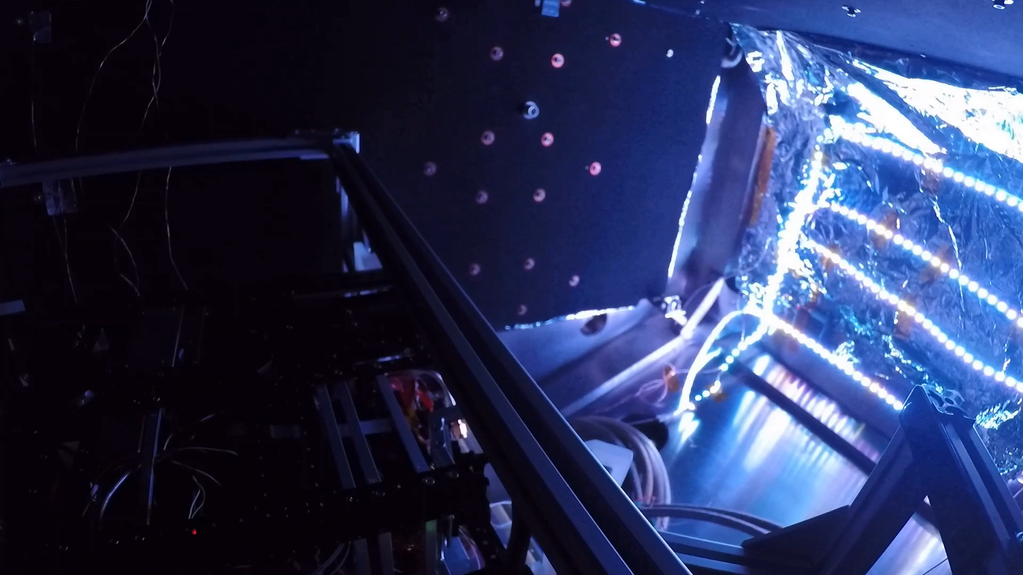

Slide 11
Summary
CatSat will demonstrate high speed communication for small satellites and collect valuable data on the Ionosphere.
My work on CatSat has spanned all its systems, fixing issues, learning procedures, and physically constructing designs.
Work continues on flight software and ground communications
CatSat passed vibrational testing last November and is ready for launch.

Slide 12
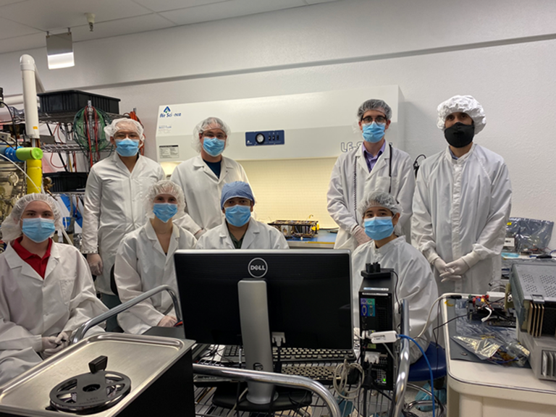
Acknowledgements
Dr. Christopher Walker and the incredible CatSat team
The University of Arizona
Freefall Aerospace
Rincon Research Corporation
NASA CubeSat Launch Initiative
Firefly Aerospace
NASA Arizona Space Grant
Image Credit: UA Communications

Slide 13
Thank You

